Slide 1
Online Recruitment Portal
Aditya Joshi(0827IT141007)
Aman Mishra(0827IT141012)
Faraz Shaikh(0827IT141038)
Rahul Patidar(0827IT141073)
Submitted to Department of Information Technology

Slide 2
Project Presentation Outline
Abstract
Introduction
Problem Statement
Survey of Existing Systems
Project Objectives
Requirement Analysis
Solution Proposed
Models and Diagrams
The implementation
Test Cases
The Outcome discussion
Conclusions and Limitations

Slide 3
Abstract
The online recruitment is an Indian Job Portal Founded by student of Aitr ,Indore Students in the year 2018.It is forever pushing the boundaries with new edge innovation and technology. efforts are continuously made to improve the job search of the site and make it more efficient for users. it is intended to serve as a preliminary medium of contact and exchange of information for its user/members who have a bonafide to contact or to be contacted for the purpose related to genuine existing job vacancies and for other carrier enhancement service

Slide 4
Introduction
This project The online recruitment is an online website in which jobseekers can register themselves online and apply for job according to city and attend the exam.
The online recruitment provides online help to the users a online Recruitment System enables the users to have the typical examination
It resolves typical issues of manual examination processes and activities into a controlled and closely monitored work flow in the architecture of the application.
This multi platform solution brings in by default, the basic intelligence and immense possibilities for further extension of the application as required by the user.
The system makes it friendly to distribute, share and manage the examination entities with higher efficiency and easiness over the world.

Slide 5
The Problem Statement
The web-application aims at providing the candidates ability to register to this application and search for jobs, manage their accounts..With automatic features like getting candidates information, company information, getting job vacancies this web application turns out to be a very suitable one.This project is aimed at developing a web-based and central Online job portal for the HR Group for a company.

Slide 6
Survey of Existing Systems
The naukri Job search app helps you find the most relevant jobs with absolute ease even on the move. Make your next big career move with a simple registration process using the naukri Job search app.the most widely visited naukri job search is a powerful job hunting tool that brings openings & job opportunities from best places to work across sectors.
Fresherworld.com
Firstjobzz.com

Slide 7
The advantages of online recruitment
Cost effective
Online recruitment is quick
Online recruitment gives you a better chance of success
Online recruitment gives you a bigger audience
Online recruitment is easy

Slide 8
The disadvantages of online recruitment
Too many candidates-It is a fact that dealing with irrelevant and bad candidates is the main problem of a HR manager. Spam candidates can waste lot of time.
It won't always work-online recruitment doesn't work every time. Every job vacancy cannot be posted or filled online. There will always be difficult-to-fill jobs that can only be filled by recruitment consultants, headhunters or in other ways.

Slide 9
Objectives
The objective of this project is to provide the information about new jobs . A user can search jobs according to their location or their skills. It provide the resume tips and interview tips which is useful to provide the guideness to the user. The system is an online application that can be accessed throughout the organization and outside as well with proper login provided. This system can be used as an Online Job Portal for job seekers.

Slide 10
Requirement Analysis
Functional components of the project:
A person should be able to
Access/ Search CVs/information from the first page (only read access).
Login to the system through the first page of the application
Change the password after logging into the system
Upload his/her CV.
See/change his/her details.
Get help about the application on how to use the different features of the system.
An admin login should be present who can read as well as remove any uploads.

Slide 11
.
Non-functional Requirements
Secure access of confidential data (user’s details) should be provided.
24 X 7 availability of the application
Application should be accessible over Internet.
Better component design to get better performance at peak time
Flexible service based architecture will be highly desirable for future extension.

Slide 12
Hardware Specification :
CPU : PENTIUM IV PROCESSOR
SPEE : 2GHz TOTAL
RAM : 128 MB
HARD DISK : 40 GB
KEYBOARD : 105 KEYS
MOUSE : LOGITECH MOUSE
Software Specification :
FRONT END : HTML ,CSS, JSP
BACK END : MYSQL,NETBEANS
OPERATING SYSTEM : WINDOWS 7

Slide 13
Solution proposed
Companies are always looking for good employees and employees are always looking for his/her dream’s jobs. There is a major problem in the jobs market that employers have to struggle in search of good candidates and candidates don’t know where is jobs available. Job Portal plays a role of mediator between employer and candidates.
Job search from any sector and industry
Job Search based on Education, Experience, Expertise, Location and Remuneration
Multiple Resumes upload
Free apply • Apply online

Slide 14
Models/Diagrams-
Job seeker Module.
Job Recruiter Module
Administration Module

Slide 15
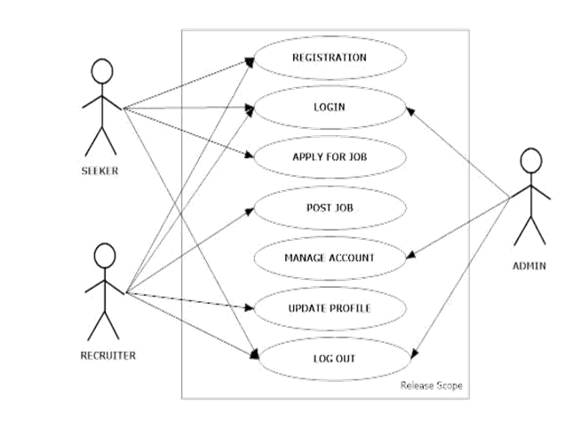
Use case Diagrams

Slide 16
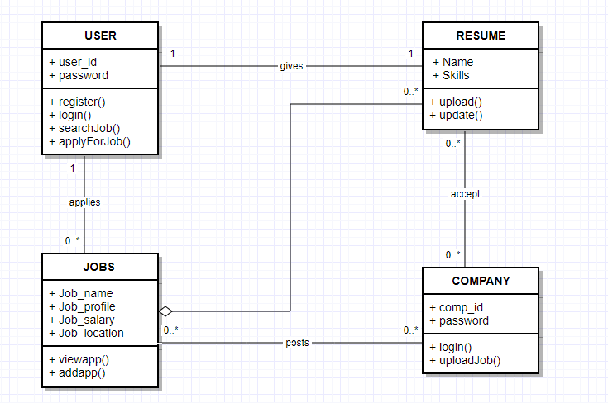
Class Diagram

Slide 17
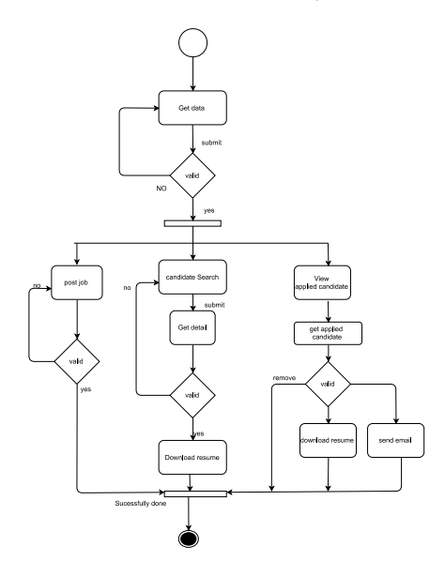
Conceptual Activity Diagram

Slide 18
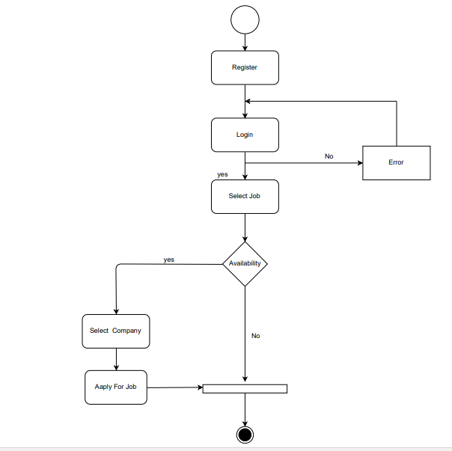

Slide 19
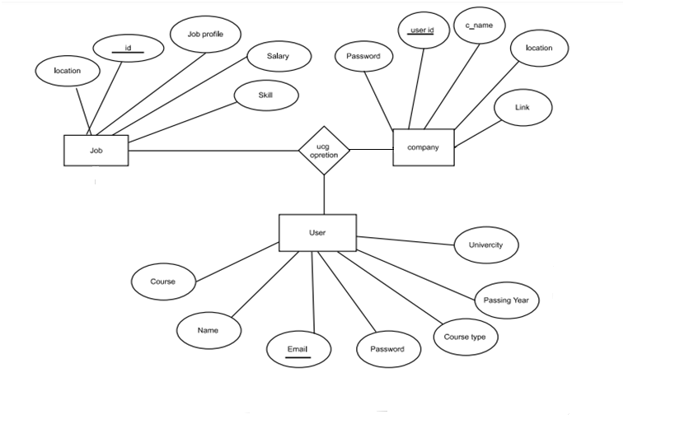
ER Diagram

Slide 20
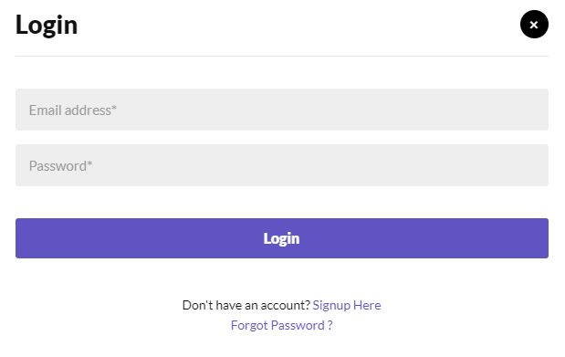
Implementation

Slide 21
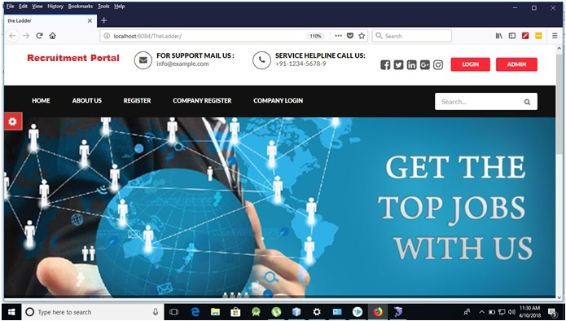
Home

Slide 22
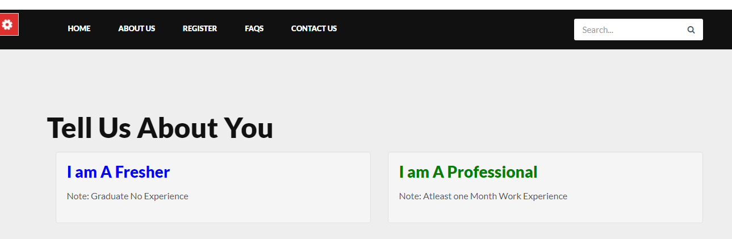

Slide 23
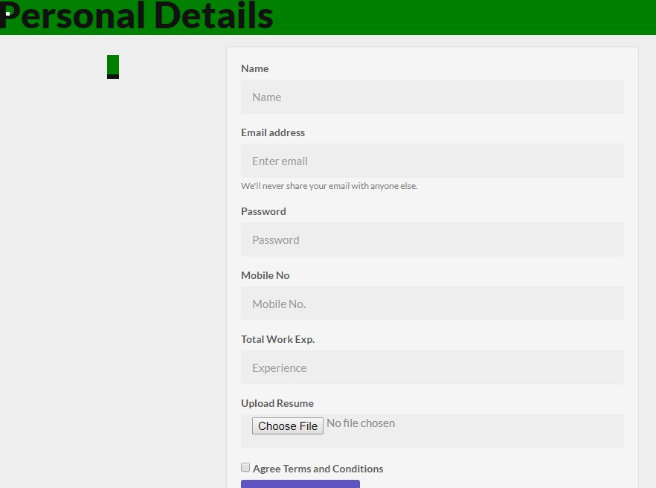

Slide 24
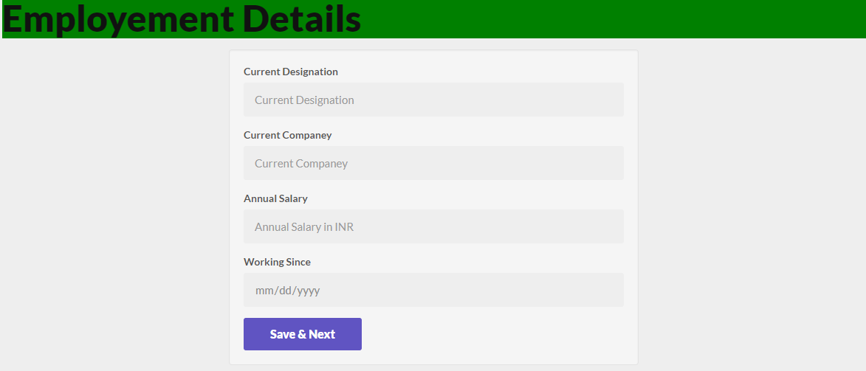

Slide 25
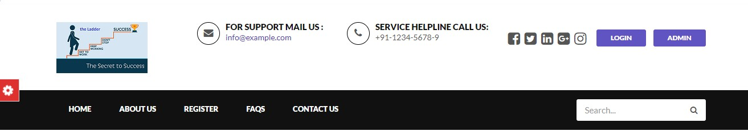
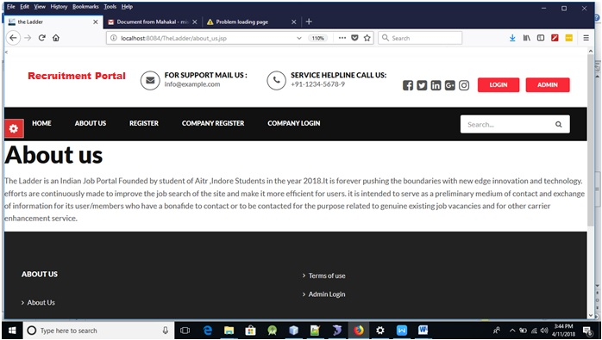

Slide 26
Testing/Test Cases
There are many type of testing methods available which is used to test our software/program. In our website we used white box testing. We are using this testing because in our website everything is clear and internally arranged. In our project the tester chooses inputs(e,g branch and subject) through our site and determines the appropriate outputs
Also in our project we use reactive approach in which the testing is not started until after design and coding are completed.
Test environment- OS :Windows,IOS
Browser: Chrome,Mozilla.

Slide 27
The Outcome discussion
Expected Outcomes -
After rounds of reconnaissance ,we aim to make a website where our motto is “our vision is your success”.The project consists of online quiz and job aspirants can also search jobs with respect to location and their respective industry.It also consists of salient features such as company registration and student registration.Then there are also company affiliates such as tech mahindra,infosys and cognizant.

Slide 28
Conclusion and Limitation
This project enables the jobseekers to find jobs according to their educational qualifications and on the other hand it is also helpful for companies to recruit required number of employees according to their needs.
Limitation
Too many candidates- It is a fact that dealing with irrelevant and bad candidates is the main problem of a HR manager. Spam candidates can waste lot of time.
It won't always work- Online recruitment doesn't work every time. Every job vacancy cannot be posted or filled online.

Slide 29
References
https://creately.com/diagram/example/hl6qam9i1/online%20job%20portal
https://www.slideshare.net/shahsmzh/online-job-portal-uml-diagrams
https://www.freeprojectz.com/entity-relationship/job-portal-system-er-diagram
https://play.google.com/store/apps/details?id=com.mycityjobsindia.app&hl=en
https://play.google.com/store/search?q=naukri%20apps&hl=en
https://play.google.com/store/apps/details?id=naukriApp.appModules.login&hl=en
https://www.docsity.com/en/srs-for-job-portal-implementation-and-applications- in- computer-sciences-project-report/86567/ http://www.guru.com/portfolio/portfolio-for-job-portal/284588

Slide 30
THANK YOU
.

